Slide 1

MANAGEMENT AND USE OF PT DATA
BY: KOLISANG PHATS’OANE,TEFO LIBATE & MAKARABO MOHAPI
CAPETOWN 03-07/06/2024

Slide 2

Background
POCT is a section in Quality Assurance Unit MOH-Lab
The HIV PT program established in 2009
6 personnel (1 MOH, 2 MOH-CDC CoAg, 2 ICAP, 1 intern)
Provides TA for 10 District
18 mother labs and approximately 375 Testing points currently
Approximately 1200 counsellors-HTS,POC EID,VL
Nurses doing other POC testing

Slide 3
Background
POCT is a section in Quality Assurance Unit MOH-Lab
QAU lab section at NRL is responsible for preparation of PT materials
6 personnel (1 MOH, 2 MOH-CDC CoAg, 2 ICAP, 1 intern)
Providing TA for 10 District
18 mother labs and approximately 375 Testing points currently
Approximately 1200 counsellors-HTS,POC EID,VL
Nurses doing all POC testing

Slide 4
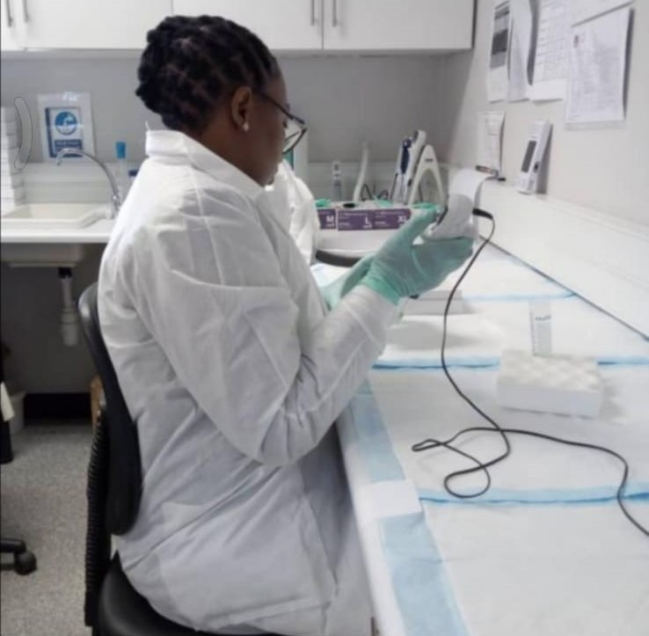
PT RESULTS RETURN. Cont.
Quality Assurance Laboratory is responsible for preparing HIV EQC and PPT samples, packaging and distribution to mother labs
Mother labs distributes samples to the sites for testing
Test and return PT results to the mother labs
We use riders for health to collect results from facilities to mother labs

Slide 5

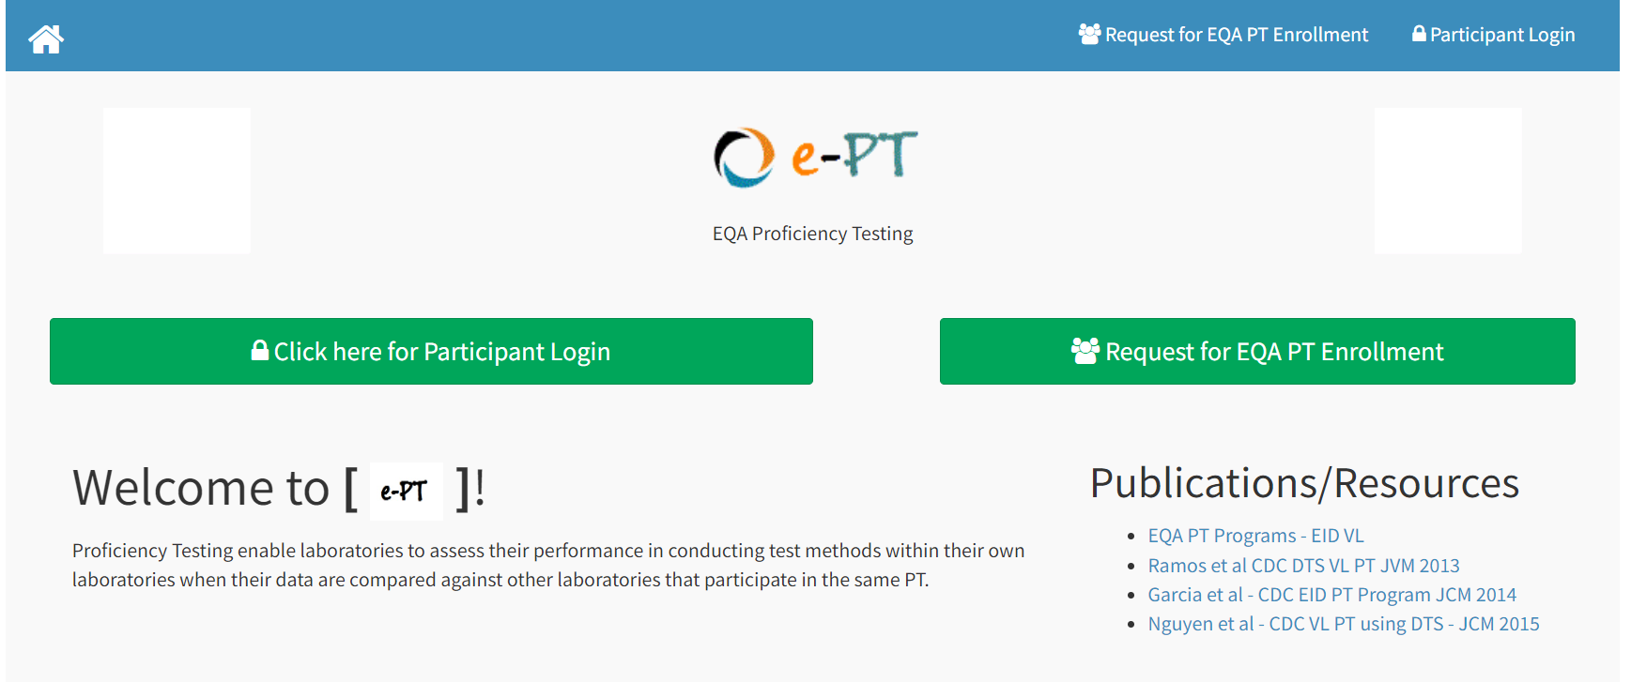
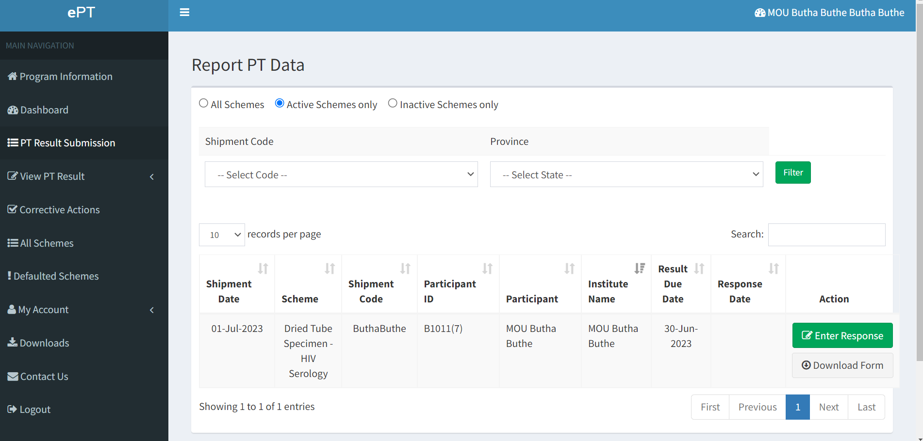

Results return cont
Previously
Facility
Mother lab
NRL-QAU
Currently
Facility
Mother lab

Slide 6
PPT results for past 6 years

Slide 7
PT data usage
Assess operations at the testing site to determine quality requirements.
Used for monitoring facility performance
Used for Identifying needs for training
Targeted supervision and Monitoring
Help us in identifying risk and doing corrective actions
Comparison of results with peer testers
Built confidence of testers in case PPT passed

Slide 8
Achievements
Preparations of monthly HIV QC and biannual PT except lockdown during COVID-19 pandemic
Collaboration with implementing partners
PPT participation over 80% and pass rate over 90% for more than the past 6 years
Training of QAU staff in ISO 15189, 9001 and 17043
Migration to capturing PPT results using ePT.
Training of testers
Effective site supportive supervision and monitoring

Slide 9
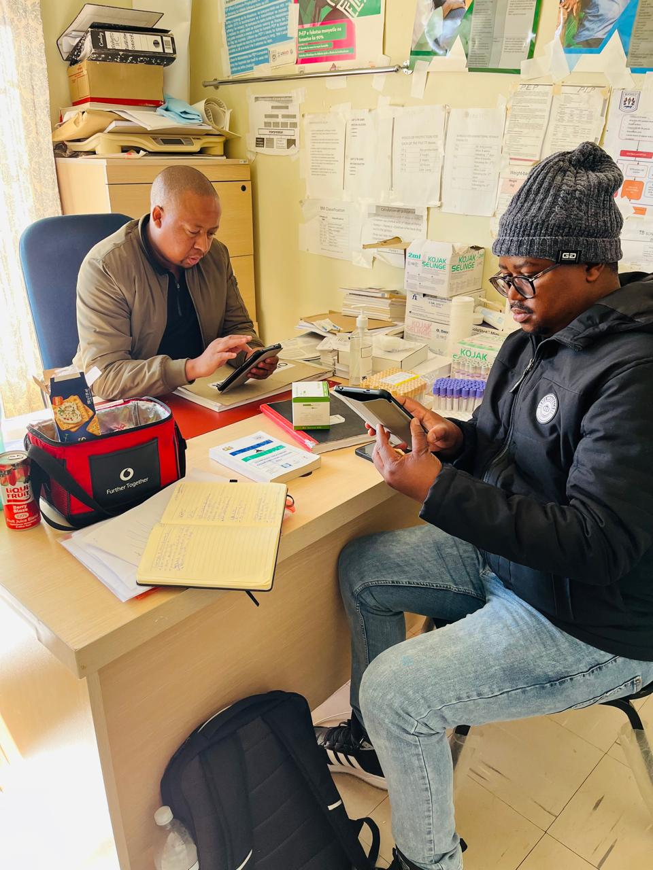
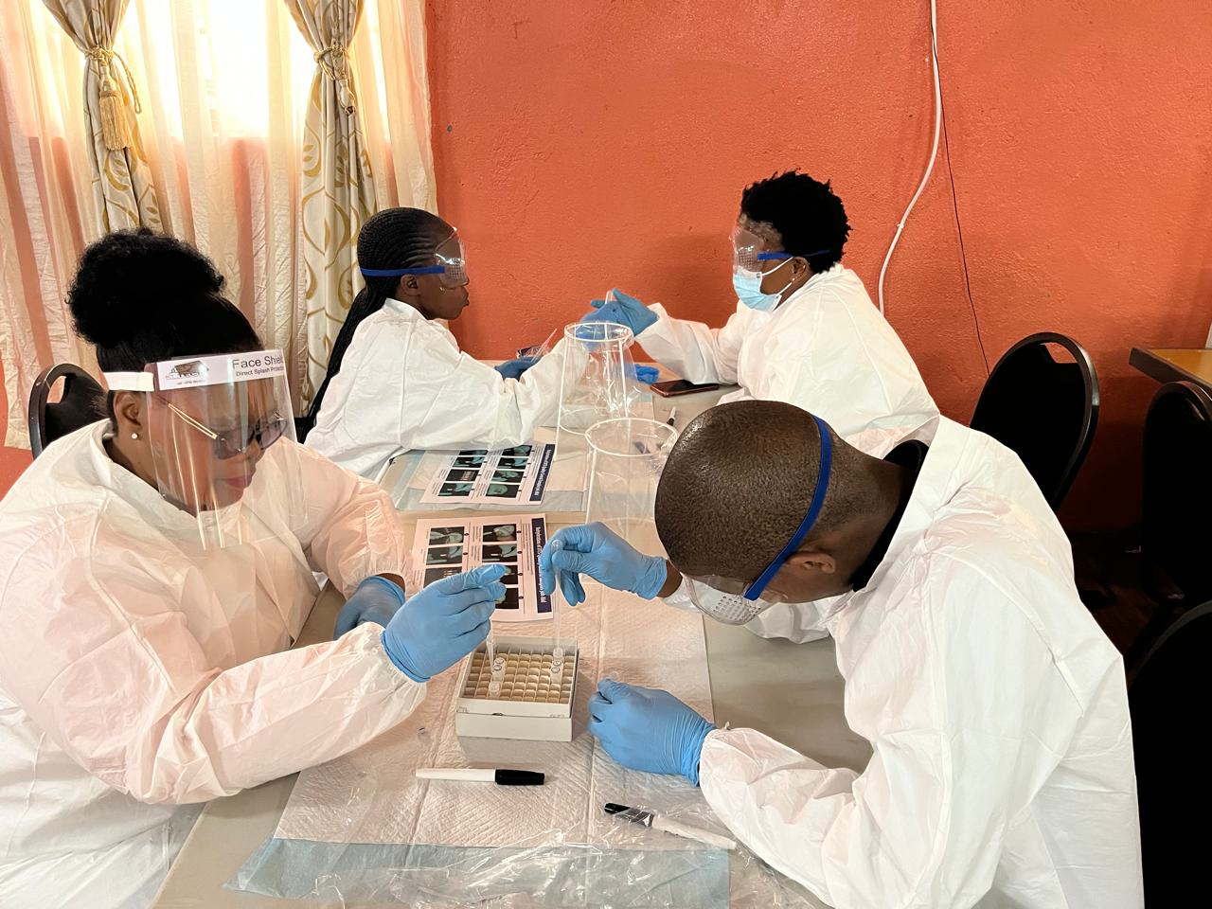

Achievements Cont.

Slide 10
Challenges
Inadequate resources to support activities
Challenges with ePT-dashboard understanding
Other labs not fully utilizing ePT
Delays in airtime/data issuing to navigate the dashboards
Printing of tester certificates.

Slide 11
Recommendations
Establishing QA-lab for accreditation on ISO 17043
Advocacy for recruitment of more POCT Officers
Timely follow-up with Mother labs to report PT data for proper monitoring of the sites.
Ensure ownership and sustainability of ePT at mother labs
Scaling up ePT at the facility level.
Develop a robust tester and site certification program
Advocacy for adequate resources to support the program

Slide 12
REA LEBOHA-THANK YOU

